Slide 1
Chapter 5
Memory Management
115/11/07
os8-2008

Slide 2
Outline
Background
Swapping
Contiguous Allocation
Paging
Segmentation
Segmentation with Paging
Examples: Pentium, Multics
115/11/07
os8-2008

Slide 3
Background
Input queue – collection of processes on the disk that are waiting to be brought into memory to run the program.
User programs go through several steps before being run.
Main memory and registers are only storage CPU can access directly
Register access in one CPU clock (or less); Main memory can take many cycles
Cache sits between main memory and CPU registers
Protection of memory required to ensure correct operation
115/11/07
os8-2008

Slide 4
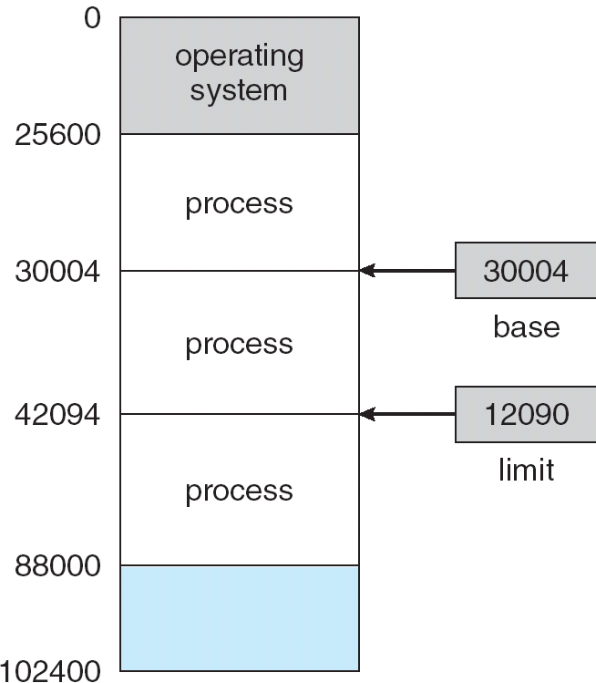
Base and Limit Registers
A pair of base and limit registers define the logical address space
115/11/07
os8-2008

Slide 5
Binding of Instructions and Data to Memory
Address binding of instructions and data to memory addresses can
happen at three different stages.
Compile time: If memory location known a priori, absolute code can be generated; must recompile code if starting location changes.
Load time: Must generate relocatable code if memory location is not known at compile time.
Execution time: Binding delayed until run time if the process can be moved during its execution from one memory segment to another. Need hardware support for address maps (e.g., base and limit registers).
115/11/07
os8-2008

Slide 6

Multistep Processing of a User Program
115/11/07
os8-2008

Slide 7
Logical vs. Physical Address Space
The concept of a logical address space that is bound to a separate physical address space is central to proper memory management.
  Logical address – generated by the CPU; also referred to as virtual address.
  Physical address – address seen by the memory unit.
Logical and physical addresses are the same in compile-time and load-time address-binding schemes; logical (virtual) and physical addresses differ in execution-time address-binding scheme.
compiler: symbol --> relocatable address
loader: relocatable address -> absolute address
115/11/07
os8-2008

Slide 8
Memory-Management Unit (MMU)
Hardware device that maps virtual to physical address.
In MMU scheme, the value in the relocation register is added to every address generated by a user process at the time it is sent to memory.
The user program deals with logical addresses; it never sees the real physical addresses.
115/11/07
os8-2008

Slide 9

Dynamic relocation using a relocation register
115/11/07
os8-2008

Slide 10
Dynamic Loading
Routine is not loaded until it is called.
Better memory-space utilization; unused routine is never loaded.
Useful when large amounts of code are needed to handle infrequently occurring cases.
No special support from OS is required implemented through program design.
115/11/07
os8-2008

Slide 11
Dynamic Linking
Linking postponed until execution time.
Small piece of code, stub, used to locate the appropriate memory-resident library routine.
Stub replaces itself with the address of the routine, and executes the routine.
  First time a stub is performed
      1. Locate or load the routine
      2. Replace itself with address of the routine
OS needed to check if routine is in processes’ memory address.
Dynamic linking is particularly useful for libraries.
solve protection if in another space
115/11/07
os8-2008

Slide 12
Overlays
Keep in memory only those instructions and data that are needed at any given time.
Needed when process is larger than amount of memory allocated to it.
Implemented by user, no special support needed from OS, programming design of overlay structure is complex
115/11/07
os8-2008

Slide 13

Overlays for a Two-Pass Assembler
115/11/07
os8-2008

Slide 14
Swapping
A process can be swapped temporarily out of memory to a backing store, and then brought back into memory for continued execution.
Backing store – fast disk large enough to accommodate copies of all memory images for all users; must provide direct access to these memory images.
Roll out, roll in – swapping variant used for priority-based scheduling algorithms; lower-priority process is swapped out so higher-priority process can be loaded and executed.
Major part of swap time is transfer time; total transfer time is directly proportional to the amount of memory swapped.
Modified versions of swapping are found on many systems, i.e., UNIX, Linux, and Windows.
System maintains a ready queue of ready-to-run processes which have memory images on disk
related to binding methods
115/11/07
os8-2008

Slide 15

Schematic View of Swapping
115/11/07
os8-2008

Slide 16
Contiguous Memory Allocation (1)
relocation register + limit register
MMU:
OS
limit
relocation
register
register
relocation
register
logical
address
yes
physical
address
CPU
<
no
limit
register
trap; address error
memory
115/11/07
os8-2008

Slide 17
Contiguous Allocation (2)
Multiple-partition allocation
  Hole – block of available memory; holes of various size are scattered throughout memory
  When a process arrives, it is allocated memory from a hole large enough to accommodate it
  Operating system maintains information about:
  a) allocated partitions b) free partitions (hole)
OS
OS
OS
OS
process 5
process 5
process 5
process 5
process 9
process 9
process 8
process 10
process 2
process 2
process 2
process 2
115/11/07
os8-2008

Slide 18
Multiple-Partition Allocation
multiple contiguous variable partition allocation
allocation problem: search a hole big enough for a request
      first-fit
      best-fit
      worst-fit
  By simulation, FF and BF are better than WF.
  FF is faster than BF.
115/11/07
os8-2008

Slide 19
An Scheduling Example
job queue
0
400K
2560 K
OS
process memory time
P1 600K 10
P2 1000K 5
P3 300K 20
P4 700K 8
P5 500K 15
2160 K
115/11/07
os8-2008

Slide 20
Memory Allocation and
Long-term Scheduling (FCFS)
0
0
0
OS
OS
OS
400
400
400
P1
P1
P5
P2 terminates
P1 terminates
900
1000
1000
1000
P2
P4
P4
allocate P4
allocate P5
1700
1700
2000
2000
2000
P3
P3
P3
2300
2300
2300
2560
2560
2560
external fragmentation
115/11/07
os8-2008

Slide 21
Fragmentation
internal fragmentation: memory is internal to a partition, but is not being used.
external fragmentation: free memory is enough but not contiguous.
Compaction: shuffle the memory contents to make all free memory together
  a solution to external fragmentation problem
  Selecting an optimal compaction is difficult.
  Swapping can also be combined with compaction
    compact if necessary, and then roll in a process (into a different location)
115/11/07
os8-2008

Slide 22
Compaction
0
0
OS
OS
400
400
P5
P5
900
100K
900
1000
P4
P4
Compact
1600
P3
1700
300K
1900
2000
P3
660K
2300
260K
2560
2560
115/11/07
os8-2008

Slide 23
Comparison of some Different Ways to Compact Memory
0
0
0
0
OS
OS
OS
OS
300
300
300
300
P1
P1
P1
P1
500
500
500
500
P2
P2
P2
P2
600
600
600
600
400K
P3
P4
1000
1000
P4
1000
1000
900K
P3
P3
1200
1200
1200
1200
300K
1500
1500
900K
1500
900K
1500
P4
P4
1900
1900
1900
1900
P3
2100
200K
2100
2100
2100
original allocation moved 600K moved 400K moved 200K
115/11/07
os8-2008

Slide 24
Paging
Logical address space of a process can be noncontiguous
Divide physical memory into fixed-sized blocks called frames (size is power of 2, between 512 bytes and 8192 bytes).
Divide logical memory into blocks of same size called pages.
Keep track of all free frames.
To run a program of size n pages, need to find n free frames and load program.
Set up a page table to translate logical to physical addresses.
Internal fragmentation
115/11/07
os8-2008

Slide 25
Address Translation Scheme
Address generated by CPU is divided into:
  Page number (p) – used as an index into a page table which contains base address of each page in physical memory.
  Page offset (d) – combined with base address to define the physical memory address that is sent to the memory unit.
  logical address:
  page number (p) + page offset (d)
☺:
  No external fragmentation
  shared pages
115/11/07
os8-2008

Slide 26
Paging model of logical and physical memory
frame number
page table
page 0
0
0
1
page 1
1
1
page 0
4
page 2
2
3
2
3
page 3
7
3
page 2
logical memory
4
page 1
5
6
7
page 3
Example: page size = 1 K
(2, 13) ----------------> (3*1K + 13)
----------------> 0110000000000 + 0000001101
----------------> 0110000001101
115/11/07
os8-2008

Slide 27
Paging hardware for address translation
(dynamic relocation)
logical
address
physical
address
CPU
page table
p d
f d
physical
memory
p
f
115/11/07
os8-2008

Slide 28

Free Frames
Before allocation
After allocation
115/11/07
os8-2008

Slide 29
Discussions
☺No external fragmentation
☹Internal fragmentation: 1/2 page in average
    suggesting a smaller page size in the past
Page sizes have grown over time (2~4 Kbyte today)
  memory, process, data sets have become larger
  better I/O performance
  page table is smaller
Frame table: an entry for each physical frame
    free or allocated
    (if allocated) to which page of which process
115/11/07
os8-2008

Slide 30
Implementation of Page Table
Page table is kept in main memory
Page-table base register (PTBR) points to the page table.
Page-table length register (PRLR) indicates size of the page table.
In this scheme every data/instruction access requires two memory accesses. One for the page table and one for the data/instruction.
The two memory access problem can be solved by the use of a special fast-lookup hardware cache called associative memory or translation look-aside buffers (TLBs)
Some TLBs store address-space identifiers (ASIDs) in each TLB entry – uniquely identifies each process to provide address-space protection for that process
115/11/07
os8-2008

Slide 31
Associative Memory
Associative memory – parallel search
Address translation (p, d)
  If p is in associative register, get frame # out
  Otherwise get frame # from page table in memory
  hit ratio, 16-512 registers have a hit ratio about 80-98%.
Page #
Frame #
115/11/07
os8-2008

Slide 32
Paging Hardware with TLB
logical
address
CPU
p d
page frame
no. no.
p
f
physical
address
physical
memory
f d
TLB
p
f
TLB miss
page table
115/11/07
os8-2008

Slide 33
Effective Access Time
Associative Lookup = ε time unit
Assume memory cycle time is 1 microsecond
Hit ratio – percentage of times that a page number is found in the associative registers.
Hit ratio = α
Effective Access Time (EAT)
EAT = (1 + ε) α + (2 + ε)(1 – α)
= 2 + ε – α
115/11/07
os8-2008

Slide 34
Memory Protection
Memory protection implemented by associating protection bit with each frame.
Valid-invalid bit attached to each entry in the page table:
  “valid” indicates that the associated page is in the process’ logical address space, and is thus a legal page.
  “invalid” indicates that the page is not in the process’ logical address space.
115/11/07
os8-2008

Slide 35
An example
0
1
page 0
frame No.
2
3
0
v
page 1
00000
2
page 0
1
v
4
3
page 2
page 1
2
v
4
5
3
v
page 2
7
6
4
8
v
page 3
page 3
5
v
7
9
page 4
8
6
i
page 4
10468
0
page 5
7
i
0
9
12287
page 5
page table
12290
valid but illegal
logical memory
n
115/11/07
os8-2008

Slide 36
Shared Pages
Another advantage of paging is the possibility of sharing common code, which must be reentrant.
reentrant code (pure code): It never change during execution.
Only one copy of the shared code needs to be kept in physical memory.
Two (several) virtual addresses are mapped to one physical address.
☹ system using inverted page table is difficult to implement shared pages (memory).
115/11/07
os8-2008

Slide 37
Shared Pages
0
ed 1
3
0
1
4
ed 2
1
data 1
2
6
ed 3
2
3
data 3
1
0
data 1
ed 1
3
3
page table
ed 1
1
for P1
4
process P1
ed 2
4
ed 2
2
6
ed 3
3
5
7
0
ed 1
3
data 3
page table
ed 3
6
1
for P3
4
process P3
ed 2
data 2
7
2
6
ed 3
3
8
2
data 2
page table
process P2
for P2
115/11/07
os8-2008

Slide 38
Page Table Structure
Hierarchical Paging
Hashed Page Tables
Inverted Page Tables
115/11/07
os8-2008

Slide 39
Hierarchical Page Tables
Break up the logical address space into multiple page tables.
A simple technique is a two-level page table.
115/11/07
os8-2008

Slide 40
Multilevel Paging
Two-level paging: the page table itself is also paged.
SPARC: 2-level, Motorola 68030: 3-level
page number page offset
logical address
p1 p2 d
p1
.
.
p2
.
d
outer-page table
page of
page table
desired page
115/11/07
os8-2008

Slide 41
Two-Level Paging
page 0
516
page 1
.
.
.
.
.
.
0
123
page 123
.
.
.
1
1
2
708
page 516
.
.
.
.
.
.
outer-page table
page 708
.
.
.
929
.
.
.
page 900
Example: (1K page size)
(1, 2, 121)
-> (708*1K +121)
.
.
.
900
page 929
.
.
.
page table in memory
process in memory
115/11/07
os8-2008

Slide 42
Hashed Page Tables
Common approach for handling address spaces > 32 bits.
The virtual page number is hashed into a page table. This page table contains a chain of elements hashing to the same location.
Virtual page numbers are compared in this chain searching for a match. If a match is found, the corresponding physical frame is extracted.
115/11/07
os8-2008

Slide 43

Hashed Page Table
115/11/07
os8-2008

Slide 44
Inverted Page Table
Each process has a page table, which may consist of millions entries. This may consumes large amounts of physical memory.
Solution: inverted page table
  one entry for each frame, storing the virtual address of the page stored in it.
    (process-id, page number)
  A virtual address:
    (process-id, page number, offset)
  ☺: only one table is used
  ☹: table searching time is larger
    Solution: hash + associative register (cache)
115/11/07
os8-2008

Slide 45
Inverted Page Table
logical
address
physical
address
CPU
pid p d
i d
physical
memory
i
pid p
search
inverted page table
115/11/07
os8-2008

Slide 46
Segmentation
Memory-management scheme that supports user view of memory.
A program is a collection of segments. A segment is a logical unit such as:
main program,
procedure,
function,
method,
object,
local variables, global variables,
common block,
stack,
symbol table, arrays
115/11/07
os8-2008

Slide 47

User’s View of a Program
115/11/07
os8-2008

Slide 48
Logical View of Segmentation
1
1
4
2
3
4
2
3
user space
physical memory space
115/11/07
os8-2008

Slide 49
Segmentation Architecture (1)
Logical address consists of a two tuple:
<segment-number, offset>
Segment table – maps two-dimensional physical addresses; each table entry has:
  base – contains the starting physical address where the segments reside in memory.
  limit – specifies the length of the segment.
Segment-table base register (STBR) points to the segment table’s location in memory.
Segment-table length register (STLR) indicates number of segments used by a program;
segment number s is legal if s < STLR.
115/11/07
os8-2008

Slide 50
Segmentation Architecture (2)
Relocation
  dynamic
  by segment table
Sharing
  shared segments
  same segment number
Allocation
  first fit/best fit
  external fragmentation
115/11/07
os8-2008

Slide 51

Segmentation Hardware
115/11/07
os8-2008

Slide 52

Example of Segmentation
115/11/07
os8-2008

Slide 53
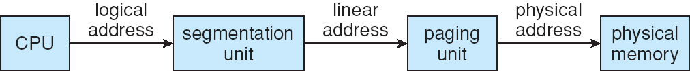
Example: The Intel Pentium
Supports both segmentation and segmentation with paging
CPU generates logical address
  Given to segmentation unit
    produces linear addresses
  Linear address given to paging unit
    generates physical address in main memory
    Segmentation and paging units form equivalent of MMU
115/11/07
os8-2008

Slide 54
Intel Pentium Segmentation (1)
max # of segments per process = 16K = 2¹⁴
size of a segment ≤ 4GB
Logical-address space is divided into 2 partitions:
1st: 8K segments (private), local descriptor table (LDT)
2nd: ≤ 8K segments (shared), global descriptor table (GDT)
Each entry in the LDT and GDT consists of an 8-byte segment
descriptor including base and limit info
Logical address is a pair (selector, offset),
selector is a 16-bit:
s
g
p
13
segment #
1
GDT or LDT
2
protection info
Pentium CPU has 6 segment registers, allowing 6 segments addressed concurrently.
Another 6 8-byte registers to hold the corresponding descriptors from LDT or GDT
115/11/07
os8-2008

Slide 55

Intel Pentium Segmentation (2)
32-bit
115/11/07
os8-2008

Slide 56
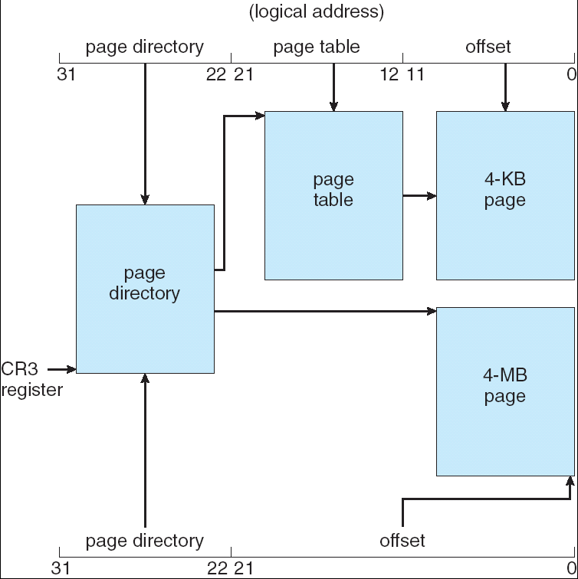
Pentium Paging Architecture
4kB
Page size:
4kB or 4 MB
outer
4MB
115/11/07
os8-2008

Slide 57
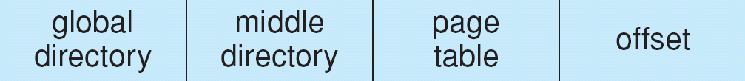
Linear Address in Linux
Linux is designated for 64-bit or 32-bit platform.
3-level paging strategy
The linear address is broken into 4 parts:
115/11/07
os8-2008

Slide 58
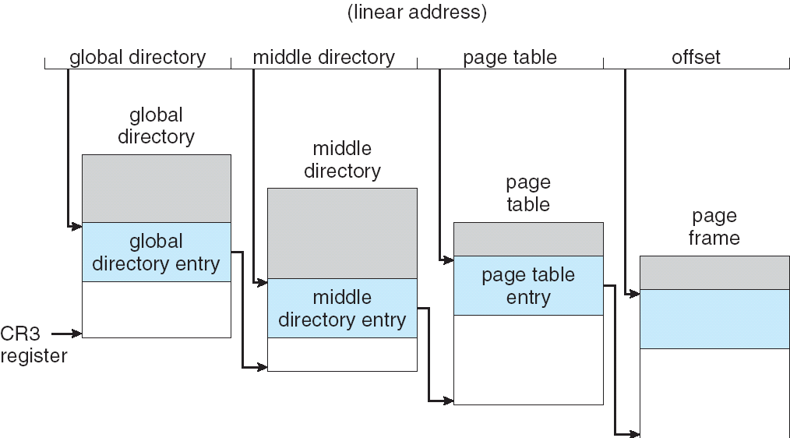
Three-level Paging in Linux
32-bit platform: middle directory is 0-bit for 32-bit Pentium
115/11/07
os8-2008

Slide 59
Protection and Sharing
Easy association of protection
  A segment represents a semantic portion and thus all entries should be used in the same way.
    Instruction section: read-only or execute-only
    put array in a segment: MMU automatically check each array index.
  Errors can be checked by hardware.
Easy to share a segment
  Problem: code segment refer to itself
  Solution
    all processes use the same segment number.
    indirect reference (offset)
115/11/07
os8-2008

Slide 60
Segmentation with Paging
Both paging and segmentation have their advantages and disadvantages.
It is possible to combine these two schemes to improve on each.
  MULTICS system:
    page the segments + page the segment table
  OS/2 32-bit version:
    page the segments + page the page tables
    (two-level paging)
115/11/07
os8-2008

Slide 61
Multics
Page the segments
    ☺: 1. No external fragmentation
    2. allocation is trivial and fast
    ☹: 1. internal fragmentation
    2. slower
Page the segment table
    ☺: page table do not need a large contiguous
    memory
115/11/07
os8-2008

Slide 62
Paged segmentation on GE645 (MULTICS)
logical address
s d
16 bits
yes
18 bits
d
≥
+
segment page-table
length base
p d’
no
10 bits
memory
segment table
6 bits
STBR
+
f d’
1K
f
segment table base register
physical
address
page table
for segment s
115/11/07
os8-2008

Slide 63
Address Translation in MULTICS
logical address
segment
number
offset
s1 s2 d1 d2
8 10 6 10
s1
.
.
s2
.
page table
for segment
table (256)
d1
page of
segment table
(1K)
d2
page table
for segment
(64)
page of segment
(1K)
115/11/07
os8-2008

